Slide 1
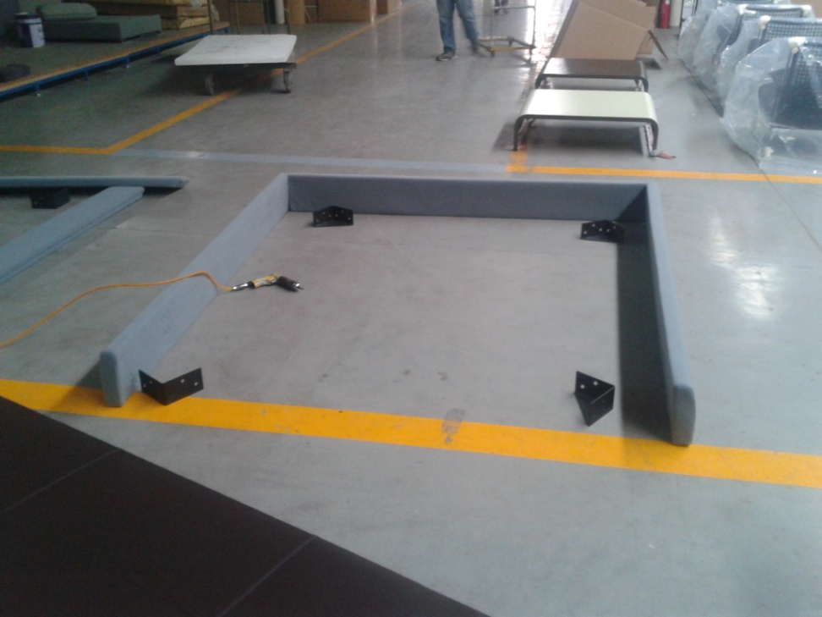
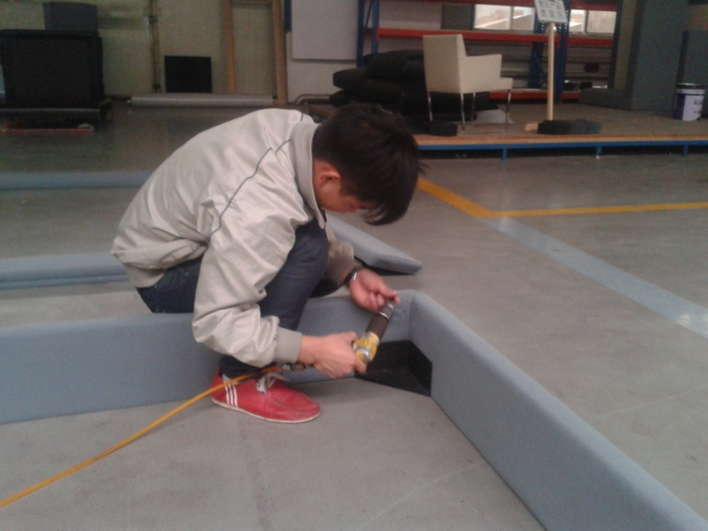
Step 1: Combine the 3 bed slides by corner connectors
Notes:
Step 1

Slide 2
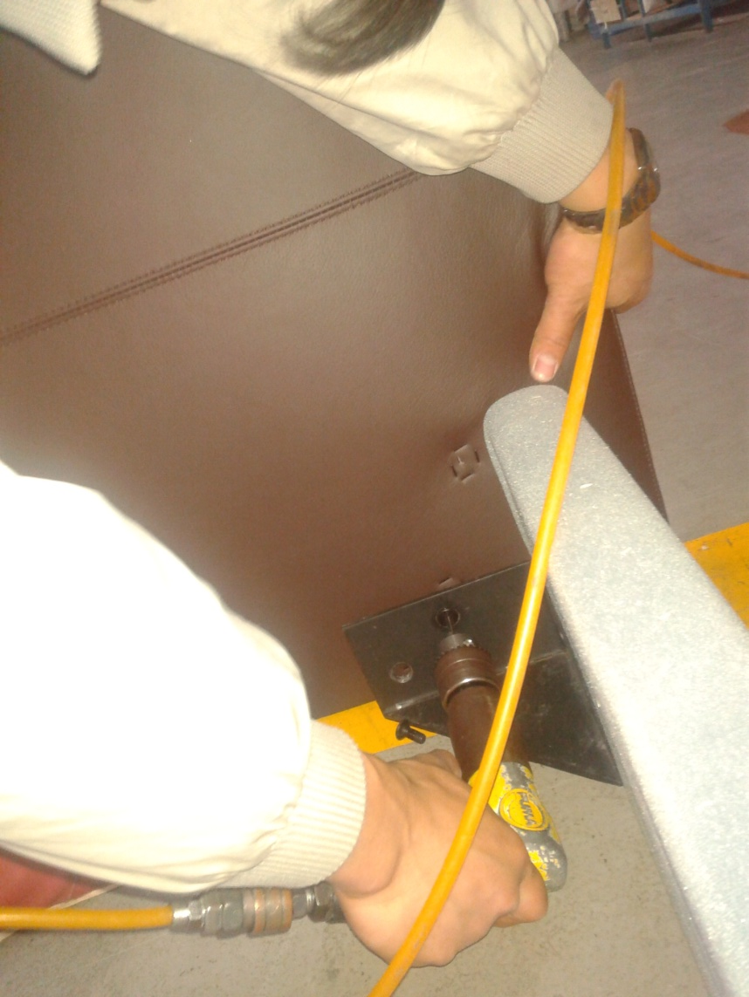
Step 2: Connect the head board with bed sides by corner connectors
Notes:
Step 2 You can put on the head board cover if you ordered fabric cover

Slide 3
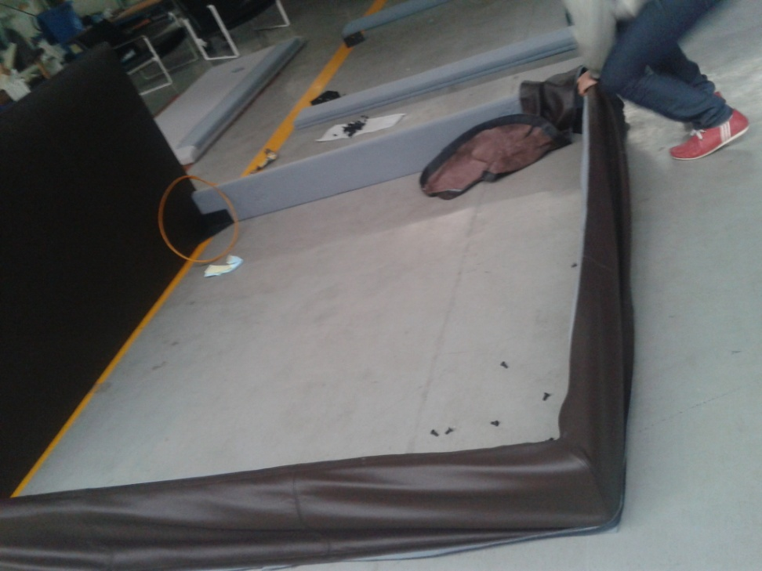
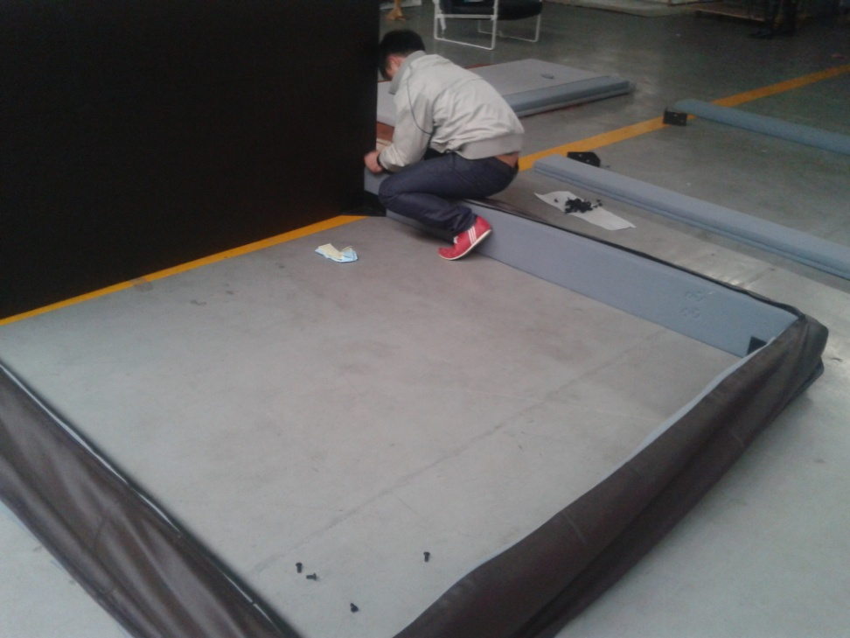
Step 3: Put on the side board covers
Notes:
Step 3

Slide 4
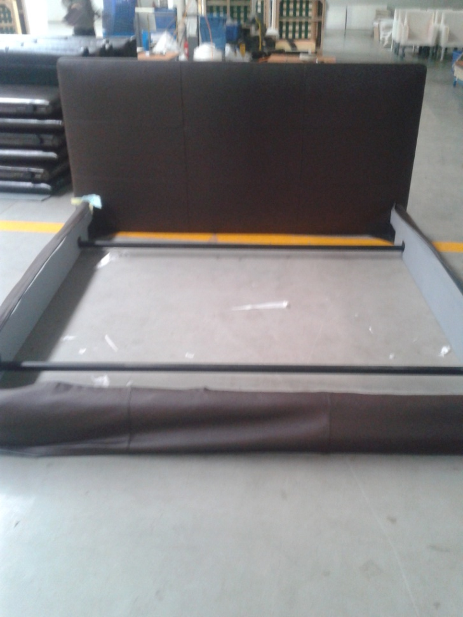
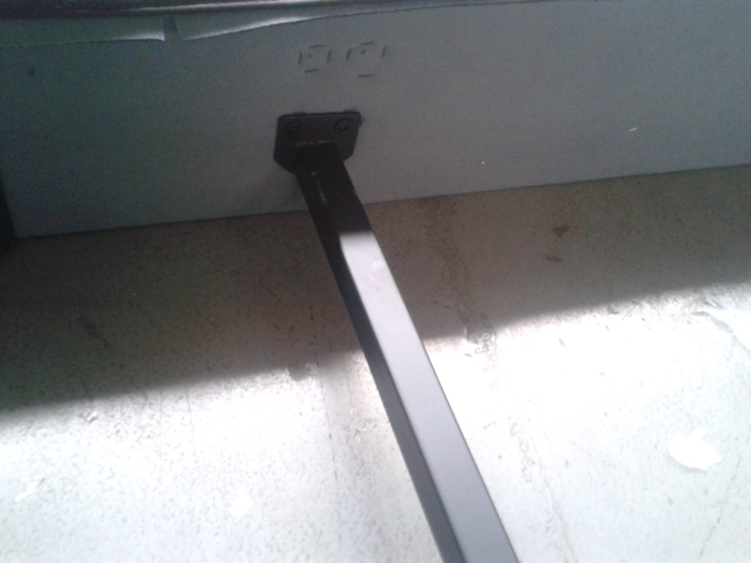
Step 4 : Install 2 cross braces
Notes:
Step 4

Slide 5
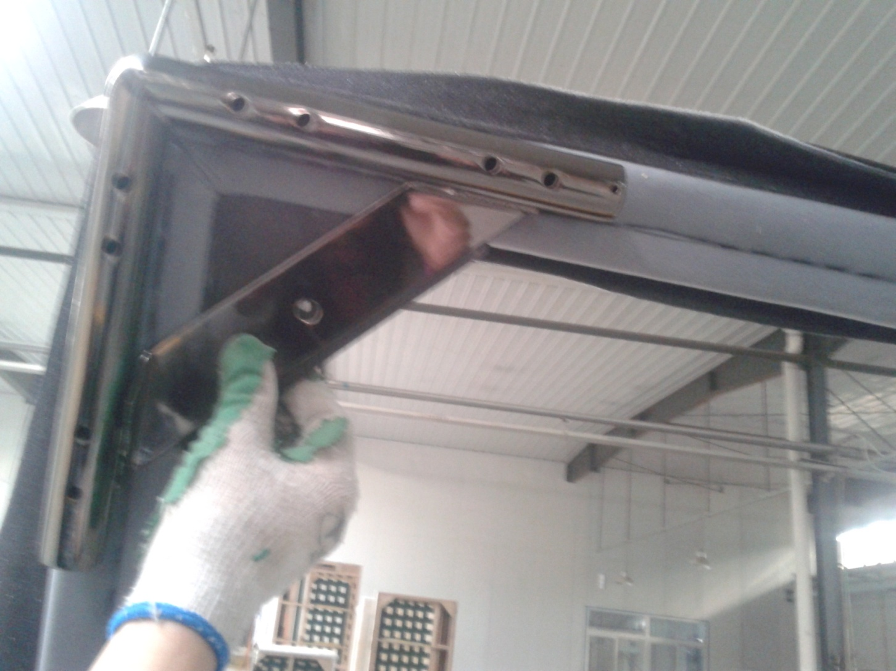
Step 6: Install 4 bed legs
Notes:
Step 6

